Slide 1

2020 CIDD ‘VIRTUAL’ COMMUNITY TALK SERIES
Presenting Jean Mankowski, PhD
“Positive Behavior Management Strategies for Working with Individuals
with Intellectual or Developmental Disabilities During COVID-19 Times"
Questions you have during the presentation may be typed in the
chat box and will be answered at the end of the talk as time permits.

Slide 2

Positive Behavior Management Strategies for Working with Individuals with Intellectual or
Developmental Disabilities During COVID Times
Jean B. Mankowski, PhD
August 12, 2020
Carolina Institute for Developmental Disabilities
UNC School of Medicine
Notes:
Introduce self and BMC work
IDD= intellectual AND / OR Developmental Disabilities

Slide 3

COVID19
What changed?
Schools went virtual or cancelled
Workplaces closed for many
Some were required to work in risky conditions
Therapies were cancelled or went virtual
Response & accessibility to virtual platforms varied
Many community supports stopped
Many community activities were off limits
Schedules were disrupted
Family stress increased
Group home consumers could not leave or have visitors
Many families encountered financial strain
Masks were recommended
Many parents needed to work from home and children no longer had school or childcare
Doctor’s visits went virtual or changed to strict protocols
Evaluations & less necessary procedures stopped
Household items and foods were scarce
Concern about health of loved ones increased
Those with special health care needs required extra protection
And more, and more, and more

Slide 4

Responses Vary Greatly
Jenny’s whole world has been turned upside down. School and therapies provided her with much needed structure. She was lost for weeks.
This was our world already because of Joey’s extreme challenges being in the community. Now we must order groceries for pick up two days in advance, instead of that morning.
I feel vindicated. We already lived this way because of Amy’s compromised immune system. Now others get it.
Robert does not like school or social situations, so he has been happy as a clam. Me on the other hand, I had to go to 50% time at work to manage him during the day.

Slide 5

Changes in Support
ABA workers, respite workers, therapists, early interventionists, babysitters, and community support providers
  Some lost them because they needed to shut down risk in their home
  Some lost them because the worker/therapist was high risk
  Other families have support workers still coming to their home and enjoy the support but feel vulnerable
  Virtual therapy does not work for many
    Patient lacks attention for it
    Patient is non-verbal
    Family does not have computer or Wi-Fi

Slide 6
Overall
COVID19 Adaptations
Create a Calm/Safe Home
Reduce media exposure
Keep routines and structure (use schedule)
Answer questions honestly
(at a developmentally appropriate level)
Recognize and respond to their feelings
Model coping or management of feelings
Give facts before you leave
(where you are going, time of return,
safety measures you will take)
Increase praise and reassurance
Stay connected virtually with friends and
family members
Look forward/ Make plans

Slide 7
Encourage Their Self Care
Regular
Exercise
Out-side Time
Virtual Classes (yoga, exercise, art, etc.)
Encourage virtual interaction with friends and family
Making Healthy Choices
Notes:
DON’T FORGET YOUR OWN

Slide 8
Keep Busy and Fight Boredom
Virtual Tours of museums, state parks, aquariums, field trips etc.
Cooking
Crafts (Good Housekeeping.com)
Digital Books and Book Reading Events
Watch a Movie with Questions to Answer
Online Brain Games
Online Classes (coding, yoga, drawing)
Virtual Classes (Khan Academy)
Scavenger Hunts
Set up pretend play scenarios (vet, grocery store, teacher)
Notes:
ASNC has a great list of structured activities https://www.autismsociety-nc.org/staying-structured-coronavirus/

Slide 9
What is Challenging Behavior
Defined differently by different people
For our purposes:
Challenging behavior is behavior that has an impact on one’s quality of life

Slide 10
Impact on the Individual / Self
Interferes with learning
Interferes with independence
Limits experiences
Causes physical problems (self-injury, injury from aggression)
Reduces confidence / self-esteem
Causes isolation

Slide 11
Impact on Family
Increases stress
Can increase anxiety or depression in parents or sibling
Can increase feelings of isolation
Fears of harm to self, sibling, staff
Parents have less time for other children, recreation, work
Behavior can be dangerous
Can overwhelm a family’s ability to cope
Need for supervision is difficult for those needing to work
Can cause financial strain

Slide 12

Challenges in Mental Health and IDD
Psychiatric or mental health disorders are estimated as 2 - 4 times more likely in individuals with IDD.
Determining an accurate psychiatric diagnosis is more difficult as the level of functioning or intellect declines.
Researchers have found as many as 1/3 of individuals with IDD have significant behavioral, mental, or personality disorders requiring MH services.

Slide 13
Why are individuals with IDD vulnerable to Mental Health problems or challenging behavior?
language difficulties
limited coping or problem-solving skills
inadequate social supports
high rate of central nervous system impairment
Social rejection or stigmatization
behavioral phenotypes associated with genetic conditions

Slide 14
Both IDD and challenging behavior can affect a person’s daily functioning
Hinder educational progress
Interfere or inhibit vocational activities
Jeopardize residential placements
Disrupt family and peer relationships
Reduce quality of life
Cause social rejection and stigmatization
Increase risk of abuse/
retaliation

Slide 15
Behavior Management for
Individuals with IDD
Individuals with MH/IDD have a high rate of behavioral challenges
Behavior management is designed to respond to inappropriate behaviors and teach adaptive skills
Evidence-based treatment approaches have been empirically tested and proven effective
It is considered best practice to use evidence-based treatments developed for those with IDD to treat behavior disruptions, and teach appropriate behavior and independent skills

Slide 16
Evidence Based Treatments
Comprehensive Treatment Models (CTM)
(e.g., LEAP, Early Start Denver Model)
A set of practices used together to accomplish broad learning or developmental impact on the core deficits of ASD
have a theoretical framework
intense
occur across years
target multiple outcomes (social, communication)
Focused Intervention
(e.g., shaping, visual supports)
Individual interventions used to address a skill or behavior present in an individual with IDD or ASD
operationally defined, specific
shorter time course (weeks–months)
address specific outcomes
specific interventions are often components of CTMs
Interventions can be used together with other strategies and interventions to target different behaviors
Effective for broad range of ages, settings, behaviors
National Academy of Science Committee on Education for Children with Autism identified 10 CTMs in 2001.
National Academy review, Odom, Boyd, et al. (2010) identified 30 CTM programs operating within the U.S.
Notes:
The National Professional Development Center on ASD at FPG CDI and the National Standards Project at the National Autism Center
only comprehensive review of focused interventions (identified 28). Research between 1990 and 2017
***We are going to focus on the right side, the focused interventions in order to consider targeting specific behaviors or learning goals

Slide 17
Evidence-Based Practices Identified by the National Professional Development Center
Prompting
Reinforcement
Task Analysis
Antecedent-Based intervention
Cognitive Behavioral Strategies
Functional Communication Training
Functional Behavior Assessment
Response Interruption/Redirection
Visual Supports
Parent Implemented Intervention
Video Modeling
Sensory Integration
Exercise and Movement
Music Mediated Intervention
Social Narratives
Direct Instruction
Extinction
Naturalistic Interventions
Peer-Based Instruction and Intervention
Social Skills Training
Technology-Aided Instruction and Intervention
Augmentative and Alternative Communication
Discrete Trial Training
Time Delay
Self-Management
Differential Reinforcement of Alternative, Incompatible Behavior
Steinbrenner, J. R., Hume, K., Odom, S. L., Morin, K. L., Nowell, S. W., Tomaszewski, B., Szendrey, S., McIntyre, N. S., Yucesoy-Ozkan, S., & Savage, M. N. (2020). Evidence-based practices for children, youth, and young adults with Autism. The University of North Carolina at Chapel Hill, Frank Porter Graham Child Development Institute, National Clearinghouse on Autism Evidence and Practice Review Team.

Slide 18
Individuals with IDD show increased risk for
behavior challenges
self-injury
  (head banging, skin picking)
repetitive behavior patterns
repetitive speech patterns
noncompliance
aggression
communication impairments
complex sensory needs
emotional dysregulation

Slide 19
Intervention is warranted when behaviors are
harmful to the self or others
unsafe or destructive
distressing to the individual/family
disruptive to learning
disruptive to social functioning
hindering participation in daily living or occupational activities

Slide 20
Evaluate Priorities
Set realistic goals
Start with small steps that can build on each other
Target behaviors that are dangerous
Target skills that help to improve situations across several behavioral scenarios

Slide 21
Features of An Effective Behavioral Management Plan
Clear—understood by all family/caregivers
Consistent—family/caregivers are on the same page with the interventions, expectations, and rewards
Feasible—strategies need to be practical and available across settings and team(s)
Steady—new strategies/interventions should continue for at least 3-4 weeks
Continuity—keep strategies in place even when the behavior improves
Remember Extinction Bursts
Keep data if possible

Slide 22
Where to start?
Figure out the motivation for the behavior:
All behavior occurs for a
function or outcome!!
What purpose/function does the behavior serve?

Slide 23
Functional Behavior Analysis
A structured, systematic, and objective method for determining the communicative function underlying a maladaptive behavior for intervention planning purposes
Notes:
A functional analysis of behavior is completed to define the best approaches to use in a behavior plan/strategy. Systematic behavior programs can be implemented by family members, caregivers, or teachers in the person’s environment. Often the individual who is dually diagnosed may be able participate in the design of the behavioral program. When you have their ‘buy-in’ they might be more likely to participate and/or work toward improvement.

Slide 24
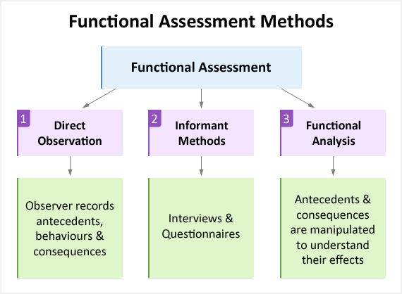

Slide 25
Components of an FBA
Describe the interfering or problem behavior
Identify antecedents and consequences
Consider the function of the behavior
Design intervention to replace behavior with a more adaptive behavior serving a similar function
Collect Data
Notes:
Antecedent—an event or ‘trigger’ that happens before an behavior (e.g., loud noise)
Consequence –the result or effect of an event (e.g., running away)
Often most helpful with considering function of: self-injury, elopement, aggression towards others, destructive behaviors

Slide 26
Informal FBAs
Did this occur in response to COVID changes?
What are they trying to communicate?
Is this happening in certain places or at certain times?
What happened before and after the behavior?
What was my response? (attention, giving-in)
What was gained?
Rule out medical / physical problems
Was this sudden? (consider illness, change)

Slide 27
Most Common Behavioral Functions
Social attention
Desired object (tangible reinforcement)
Escape
Nonsocial reinforcement
Physical discomfort
Sensory avoidance
Sensory input

Slide 28
Intervention

Slide 29
When Challenging Behavior is Communication
Teach a more functional form of communication
Replace inappropriate behavior or subtle communicative acts with more appropriate and effective communicative behaviors
Communication Breakdown:
  teach a more appropriate communication skill
    e.g., pointing to or giving a cue card, vocalization, sign
  use differential reinforcement of taught behavior
  extinction
Notes:
Specifically with individuals with autism and/or limited language skills, giving them a visual way to communicate is often easy and quickly effective.
Re: Differential reinforcement. If one is using an inappropriate manner to communicate (i.e., screaming) the caregiver might ignore the inappropriate behavior. However, as soon as an appropriate overture is made, the caregiver should immediately engage, respond, and praise the communication/communication attempt.

Slide 30
**Positive Strategies for Supporting Behavior Improvement**
Embrace a mindset that is preventative rather than in response to behavior
Set expectations by saying what you want to see instead of what not to do:
  “Thank you for staying next to me when we go into this store” instead of “Don’t run away from me in the store”
Praise and encouragement should be frequent
Praise should be specific, not generic
  “Great job putting away the dishes,” instead of “Good job”

Slide 31
Positive Strategies (continued)
Validate emotions and/or give language to teach self expression:
  “I know you wanted to see the go to they gym and now you are feeling angry that it is closed.”
Ignore low level behaviors
  whining, fidgeting, noises, repetitive behaviors
Differentiate attention toward positive or prosocial behaviors

Slide 32
Positive Strategies (continued)
Use positive language
Avoid Saying No, Don’t, and Stop
  “I like how you said excuse me,” or “Thank you for covering your mouth,” instead of, “No burping!”
  “Joe, it is time to load the dishwasher,” instead of “No yelling”

Slide 33
Response Interruption/Redirection
Use of a prompt, comment, or distractors when an unwanted behavior is occurring to divert attention away from the behavior
  Most often used to address behaviors that are repetitive, stereotypical, and/or self-injurious and/or thoughts that are perseverative
Interrupt behavior and direct to more appropriate, alternative behavior
  typically used for behaviors that are not maintained by attention or escape
  such behaviors are often maintained by sensory reinforcement

Slide 34
Positive
De-escalation
When behavior is escalating:
  be aware of warning signs /triggers
  reduce stressors in environment, if possible
  reduce language (use simple, clear, concrete language)
  pair words with visual support if possible
  keep voice neutral
  keep facial expression neutral
  give space
  give calming object
  praise attempts to self-regulate or use strategies

Slide 35
What NOT to do when
Trying to De-escalate
Give into what they want
Show anger
Raise voice
Threaten or lecture
Physically intervene unless necessary for safety

Slide 36
Positive Strategies (continued)
Visual aids, photographs or video models are great ways to teach/show expected behavior
Provide opportunities for success
Schedule breaks throughout the day for preferred activities
Allow individual to request a break when needed
  for less-verbal individuals make a visual break card available

Slide 37
Positive Strategies (continued)
Provide opportunities for choice making (available choices can be controlled)
Establish a reward system consistent with the individual’s level of understanding
Allow time to do their preference
  repetitive behavior, discussion of restricted interest, playing/looking at restricted interests
    -Does this need to be scheduled?

Slide 38

Intervention Strategies
Often Taught

Slide 39
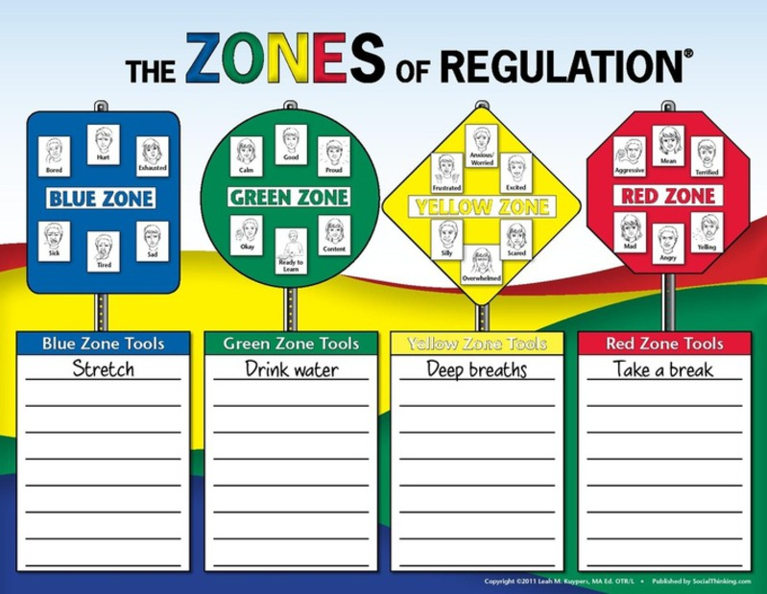
Notes:
The Zones of Regulation: A Curriculum Designed to Foster Self-Regulation and Emotional Control (2011, Social Thinking Publishing) is a curriculum developed by Leah Kuypers, M.A. Ed., OTR/L to help individuals acquire self-regulation skills. Lessons and activities assist individuals to recognize when they are in the different moods/feelings (i.e. zones) and learn the tools (e.g., sensory supports, calming techniques, strategies) to regulate toward the green zone.

Slide 40
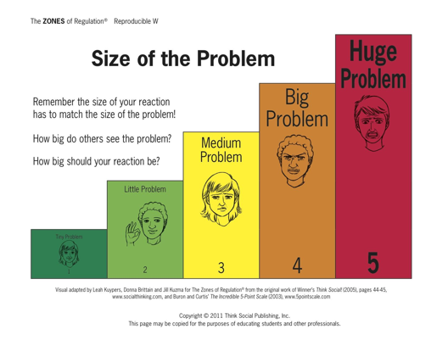

Slide 41
HOW BIG IS MY FEAR?
Notes:
From Morgan

Slide 42
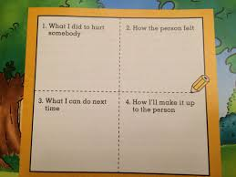
Four Square Apology

Slide 43
Social Narratives/Social Stories
Scripts used to explain the “rules” of social situations by highlighting relevant cues and defining appropriate responses
  Can be individualized
  Usually written in 1st person
  Can include visual aids
Use of these stories also helps consider various social situations with peers/co-workers/strangers
Can be created to relate to a variety of social situations and contexts, such as making introductions, getting and giving directions, or asking for help
www.thegraycenter.org/socialstories.cfm
www.rsaffran.tripod.com/social.html
www.socialstories.com/
www.autismspeaks.org/family-services/personalized-stories
Notes:
While these are most often thought of as useful for individuals with autism spectrum disorders, they can be quite effective for individuals who have less understanding of social nuances, difficulties attending to the environment around them, unease entering new/novel situations, as well as individuals prone to withdrawal and social anxiety

Slide 44
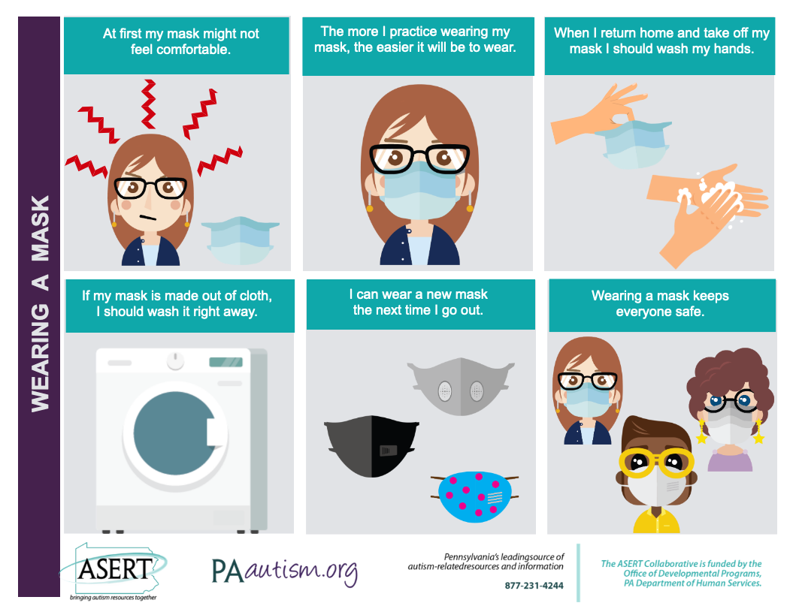

Slide 45
Visual Supports
Visual cues about one’s activity, routine, or expectation
Can be quite varied in form and function
Used to
  organize the environment
  establish expectations around activities
    schedules instructions
    work systems video modeling
  provide reminders
    timers (countdowns) activities to chose from
    appropriate behavior when something is complete
Notes:
Visual supports can be simple reminders or act to organize and structure the environment. They can be helpful for individuals who may be disorganized, confused, have attention difficulties, doing something for the first time, or having a difficult time understanding a task/environment.

Slide 46
Types of visual structure
Checklists Learning Scripts
Schedules Graphic Organizers
Scripts Partitions or tape
Photographs Physical Structure
Objects Work Systems
Drawings Visual Timers
Words

Slide 47
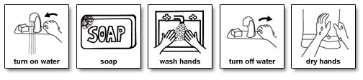
Learning Script
Detailed script for washing hands
www.do2learn.com

Slide 48
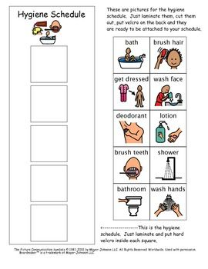

Slide 49
Introducing flexibility or more of something
Example:
(more time working independently)
  Go Slow
  Consider preferred activities before and after
  Use options of high interest (screens, swimming)
  Present options (use pictures)
  Give advance warning of when the expectation will take place.
    On schedule/calendar
    Consider a picture book to describe outing
  Start with amount of tolerated time new outing a week
  Once comfortable with this, begin introducing a bit more time
  Use verbal and visual cues to ensure they know (preferred activity) is directly afterward

Slide 50
Cognitive Coping Skills
Teach coping skills when individual is calm in and a good space
Use visuals to teach skills
Practice often
Reward practice and use!
Notes:
Visuals can serve as reminders later

Slide 51

Visual Scripts for Teaching Skills
Take Deep Breaths
Smell the flower
Blow out the candle
Smell the flower
Blow out the candle
Smell the flower
Blow out the candle

Slide 52
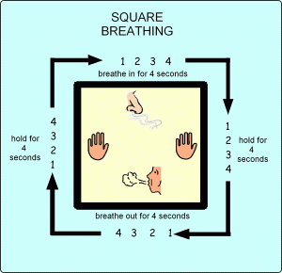

Slide 53
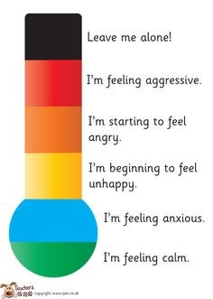
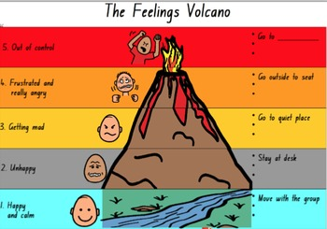

Slide 54
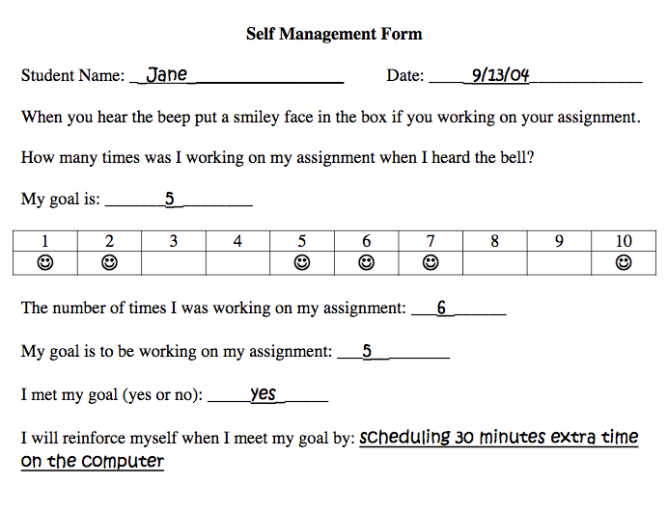
Self Management Techniques

Slide 55

Keep Others Informed staff volunteers instructors
A Dictionary of All Things Joe
words or approximations & what they mean
nonverbal cues that Joe is becoming upset
‘hot topics’ to be avoided if Joe brings them up
verbal cues that Joe is getting agitated
distractors and redirections for Joe
calming strategies Joe knows
Notes:
This dictionary will need to be updated frequently

Slide 56

Consider Structuring the Environment
Visuals
  Schedules (use pictures if needed)
  calendars
  checklists
  consistent routines
  visual timers
consider troublesome distractions or triggers in the environment (alarms, outside noise, flickering lights)

Slide 57
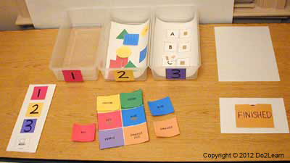
Workstation

Slide 58
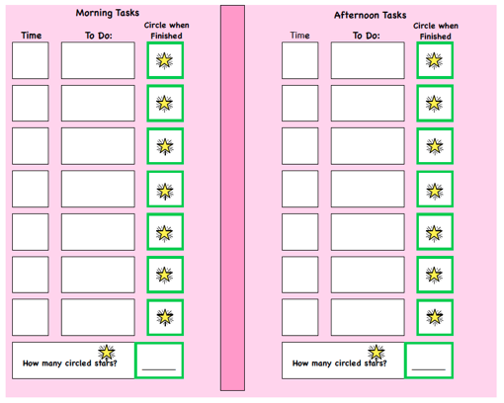

Slide 59
Calm Down Space
Designated Space
  corner of room
  large closet
  pop-up tent
Contents and Soothing Activities
  visual calming script
  bean bag
  weighted blanket
  fidgets
  soothing music
  coloring/drawing supplies

Slide 60
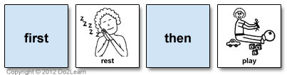
Use First Then

Slide 61

Taking a Break (or Time Out) for major infractions like aggression
Losing access to preferable things/attention by removing the individual from the rewarding setting/activity
Remove Joe from video (to other room if possible)
Use concise wording “you need a break in your room”
Do not talk to him (or provide positive or negative attention)
Keep eyes on if necessary (turn body, use gym mat)
Consider using a timer (depending on cognitive level)
Once calm/time is up, give praise of calming self down, he can to return to what he was doing
No need to rehash infraction
Example: Joe is watching a high interest video and his housemate walks by and he reaches out and hits her

Slide 62
Other less studied strategies:
Cognitive Techniques
Mindfulness
Progressive Muscle Relaxation

Slide 63

Mindfulness
More appropriate and effective for adolescents with mild to moderate ID or ASD than for those with lower cognitive ability

Slide 64
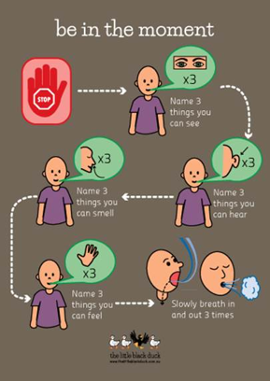

Slide 65
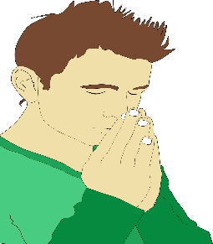


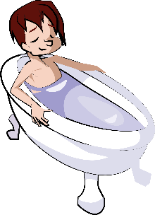


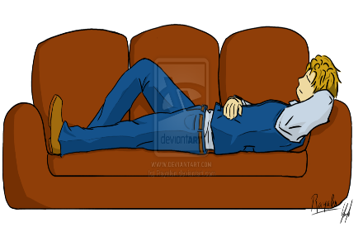
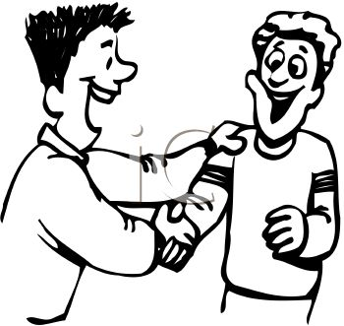
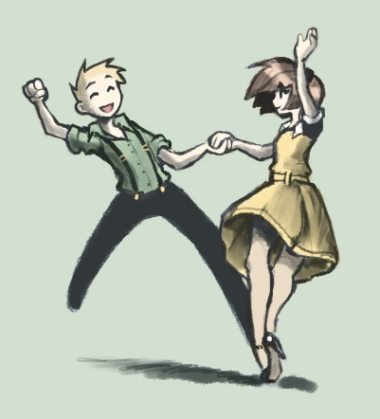


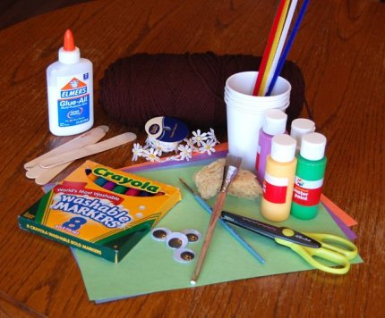
Circle a Pleasant Event

Slide 66
Websites with
Resources for COVID Times
Autism Society of NC (autismsociety-nc.org)
  Ideas for keeping busy
  Working toward wearing a mask
  Preparing for virtual school
  Social narratives about COVID topics
FPG Child Development Institute (fpg.unc.edu)
  Storybook Conversation Series
  Caring for and supporting others during this time
  A Broad variety of resources
Do2learn.com
  Terrific resources for visually supporting behavior, learning, academics, daily living skills, etc.

Slide 67
Questions???

Slide 68
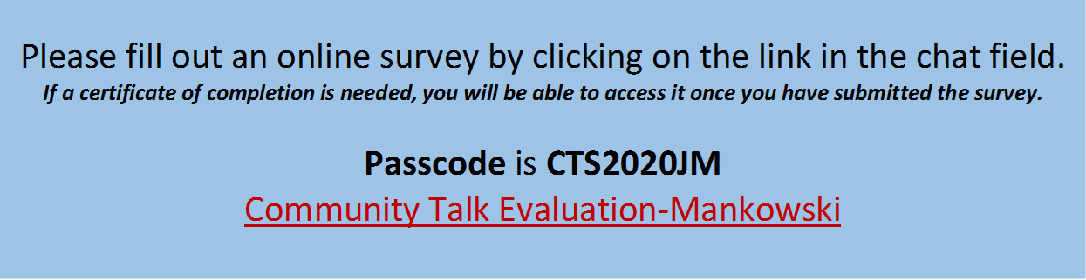
Thank you for participating in the 2020 CIDD ‘VIRTUAL’ COMMUNITY TALK SERIES
Presenting Jean Mankowski, PhD
“Positive Behavior Management Strategies for Working with Individuals
with Intellectual and Developmental Disabilities During COVID-19 Times"

Slide 69






2020 CIDD “VIRTUAL” COMMUNITY TALK SERIES presents:
Sara E. Stanton, MA, NCC (Nationally Certified START Coordinator)
Clinical Director – NC START East
Sara Stanton is the Clinical Director with NC START East. Also a graduate from the University of Pittsburgh and
Indiana University of Pennsylvania, Sara holds a Master’s of Clinical Mental Health Counseling. Her passion for crisis
intervention and with law enforcement started early during her undergraduate work at a maximum-security prison.
Sara has focused her career on crisis prevention and early intervention. Sara also has experience training and
collaborating with Law Enforcement in Eastern North Carolina to provide the internationally recognized training
model of the Crisis Intervention Team (CIT).
“Law Enforcement and ID/DD: Strategies for Success”
To explore the interactions between law enforcement and individuals with intellectual and developmental disabilities
as well as provide strategies for increasing successful outcomes integrating a systems perspective.
Learning objectives:
1. Explore trends that describe the relationship between individuals with Intellectual and Developmental Disabilities and Law Enforcement
2. Dialogue regarding proactive strategies for engaging local law enforcement in crisis prevention and intervention for those with ID/DD
3. Describe some tools that can be helpful for positive outcomes when engaging law enforcement for crisis response
WEDNESDAY, SEPTEMBER 9, 2020
6:30PM – 8:00PM
Register here: http://tinyurl.com/y6537l6x At the time of registration, you will receive a Zoom link to join the Community Talk Series.
Please direct any questions to Debbie Reinhartsen, Ph.D., CCC-SLP at Debbie.Reinhartsen@cidd.unc.edu

